Slide 2
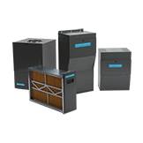
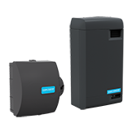
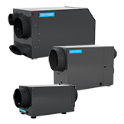

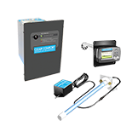
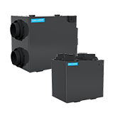
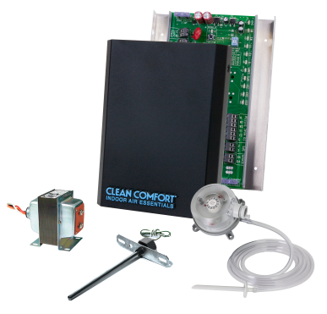
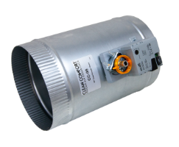
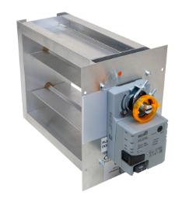
Clean Comfort Lineup
Filtration
Humidification
Dehumidification
Purification
Ventilation
Zoning
Notes:
This fall there will be a new addition to the Clean Comfort family of products.

Slide 3
Today’s Presentation Goal
Define
Clean Comfort Media Air Cleaner and Coil Purifier options.
Educate
What sets Clean Comfort options apart.
Sell
Explain the Clean Comfort offering and associated benefits.
Promote
Help you, the contractor, to make intelligent customer recommendations utilizing Clean Comfort Indoor Air Essentials.

Slide 4
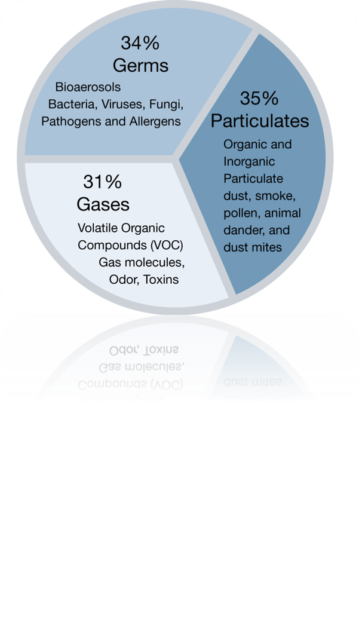
Indoor Air Pollutants
The Center for Disease Control & Prevention Categorizes Indoor Air Pollutants into ​3 Categories​

Slide 5



Three Main Indoor Air Pollutant Strategies
Source Control
Must eliminate pollutant source
Pressed wood products are significant sources of formaldehyde
Cigarette smoke creates carcinogens
Combustion appliances create emissions
Eradicate microbial growth (mold) and underlying moisture problem
Ventilation with outdoor air dilutes indoor air pollutant concentrations
Outdoor air enters buildings in three ways
Infiltration constantly introduces small amounts
Open windows and doors provide larger amounts
Supply or exhaust fans accelerate ventilation
Air cleaning (filtration) is a compliment to source control and ventilation
It is not a substitute for Source Control or Ventilation
Air cleaning alone cannot ensure adequate IAQ levels
Clean Comfort Indoor Air Essential products provide a one-stop solution to meet even the most stringent applications
Ventilation
Filtration
Notes:
Don’t spend much time on this slide and don’t try to hit all the bullets. Just hit the three keys and talk to each of them. Ask if the audience is aware of the three main air pollution factors and/or strategies. You must start by eradicating the source or contaminant. Bringing in fresh air accelerates air cleaning, everyone’s open windows in the should seasons to pull air into the home. Filtration and other Indoor Air Essential products can help maintain clean and healthy air in the home. Note that there is much more worth discussing that can’t be covered in 20 minutes but we have webinars available for additional learning. Transition into our product offering strategy.
Why Clean Comfort? Why would you want to sell our lineup instead of our competitors? Well, it’s as simple as we’re backed by the world's number 1 air conditioning company. That means you have a large company working to help you find the best indoor air quality products. All of our products are private labeled, which means we’re choosing to put our name and reputation on the line for these products. Between our company-owned and independently owned branches, we have over 1200 branches in North America. That means we can get the best price without affecting the quality of our products. Both our vendors and I have mutual excitement on the opportunity to work together. We visit them at least twice a year and meet with them on the phone monthly to make sure the relationship stays strong. We even hit the road with them to do Sales Blitz's to educate people on our products. Our Clean Comfort line is constantly changing as we get feedback from the field. If our products are hard to install or there is something you don’t like about our products. We have direct contact with that product’s manager that we can call and talk to them about it. We also are monitoring the IAQ new technologies and trends to make sure we will always have the latest and greatest stuff so you don’t have to.
With Clean Comfort you get a full product line that prides itself on

Slide 6

Understanding Air Filtration
An air cleaner's effectiveness is dependent on how well it:
Collects pollutants from indoor air.
Ability to draw air through the filtering element.
An efficient filter with a low air-circulation is ineffective.
A high air-circulation device with a poor filter is ineffective.
Long-term performance depends on proper maintenance.
Portable air cleaners lack capacity.
Require significant maintenance.

Slide 7
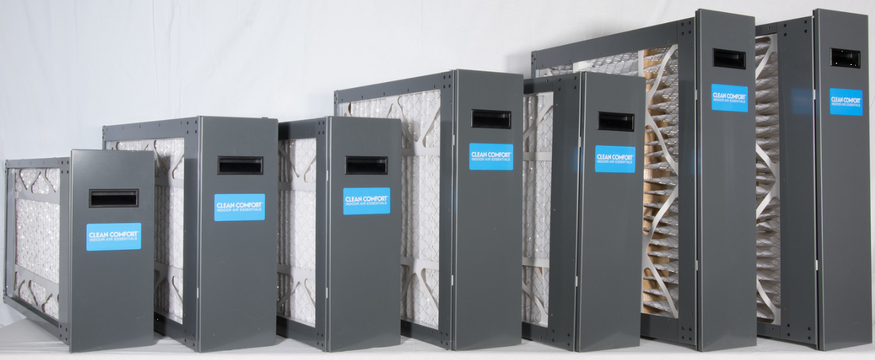
Filtration - Media Air Cleaners
Exclusive CleanFit Filters
7 cabinet sizes
Fits Goodman equipment!
  4 Furnace
  3 Air Handler
Entire cabinet color matched to
equipment
Dual gasketed door
Very low pressure drop filter
6 common filter sizes
  14 x 25
  16 x 20
  16 x 25
  20 x 20
  20 x 25
  25 x 20
AM11-CleanFit
Notes:
Media Air Cleaners for our filtration lineup is our big seller. These are the best way to get the homeowner ready to do even more for there indoor air quality, so this is like the gateway drug for IAQ. We have 7 sizes so we match up with all the furnace and air handlers we offer. We even had the builder series that is all common sizes. Every size we have is the standard size so you don’t have to worry about things not fitting once you’re at the site. A cool thing about our filters is when we ship them, we do not put our clean comfort logo on the door. This is so you can place your company logo on the door so when the homeowner sees that it’s time to replace the filter they call you not us. That way you get the recurring revenue.

Slide 8
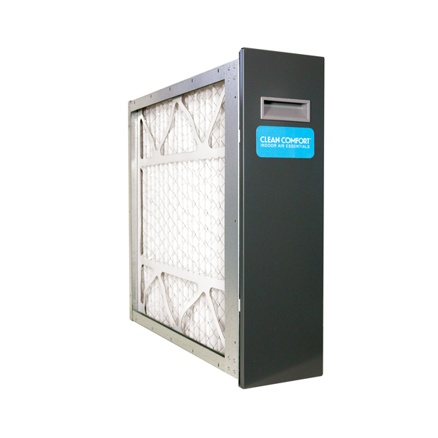
Filtration - Media Air Cleaners
Exclusive Filters
5 cabinet sizes
5 common filter sizes
  16 x 20
  16 x 25
  20 x 20
  20 x 25
  25 x 20
Door color matched to equipment
AMB11–Builder Series
Notes:
Media Air Cleaners for our filtration lineup is our big seller. These are the best way to get the homeowner ready to do even more for there indoor air quality, so this is like the gateway drug for IAQ. We have 7 sizes so we match up with all the furnace and air handlers we offer. We even had the builder series that is all common sizes. Every size we have is the standard size so you don’t have to worry about things not fitting once you’re at the site. A cool thing about our filters is when we ship them, we do not put our clean comfort logo on the door. This is so you can place your company logo on the door so when the homeowner sees that it’s time to replace the filter they call you not us. That way you get the recurring revenue.

Slide 9
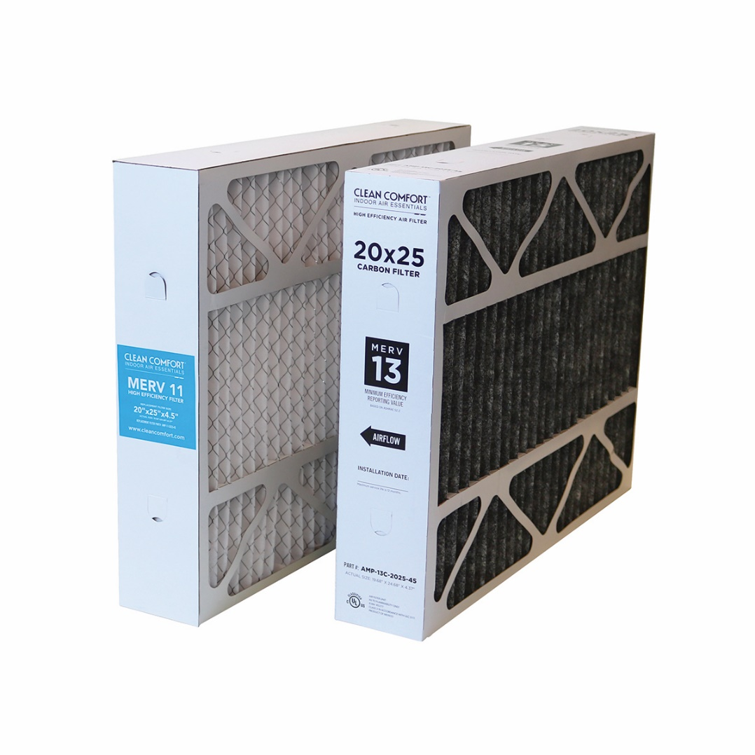
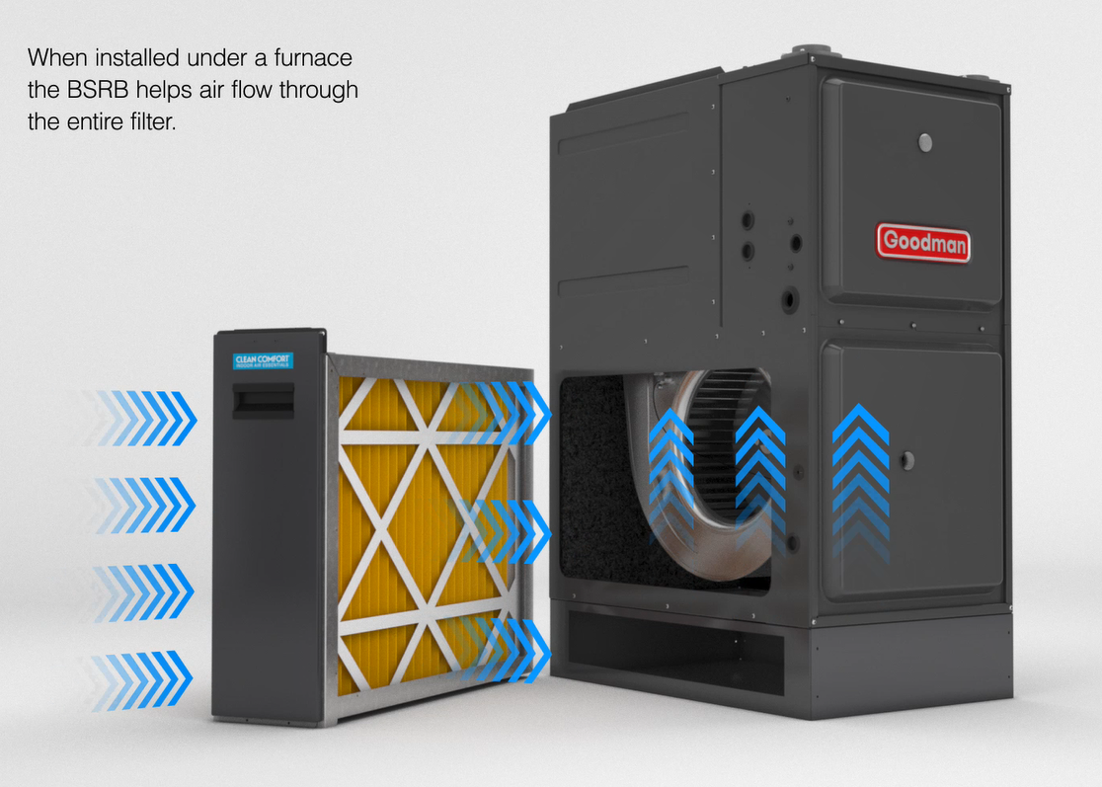
Filtration - Accessory
MERV 13 Charcoal
Furnace Risers
Notes:
To better assist your needs out in the field we have our filter accessories. So we have the MERV11 replacement filters for both the Clean Fit and Builder series but now you have the option to upgrade to a MERV13 Carbon filter. We also offer Furnace Risers that match the same paint of our furnaces and they’re highly recommended for our 4 & 5-ton units. This ensures that airflow is maximized through the filter. Air can now go through the bottom and the side of the filter and into the furnace.

Slide 10
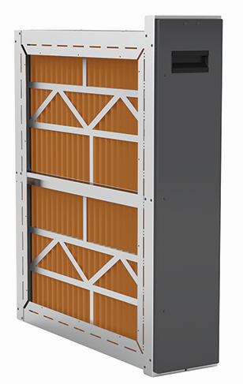
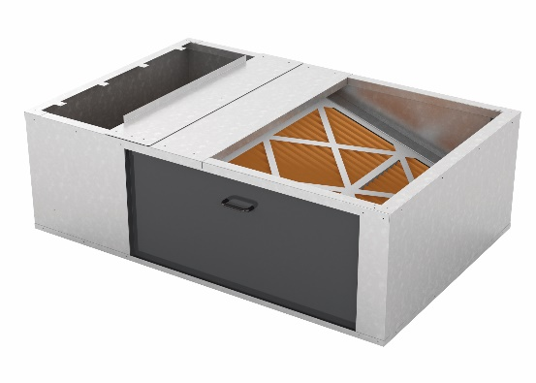
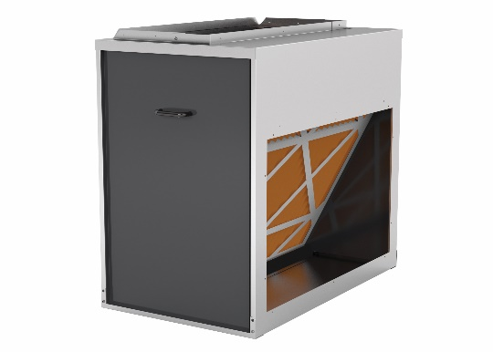
Filtration – Wide Array of Options

Slide 11
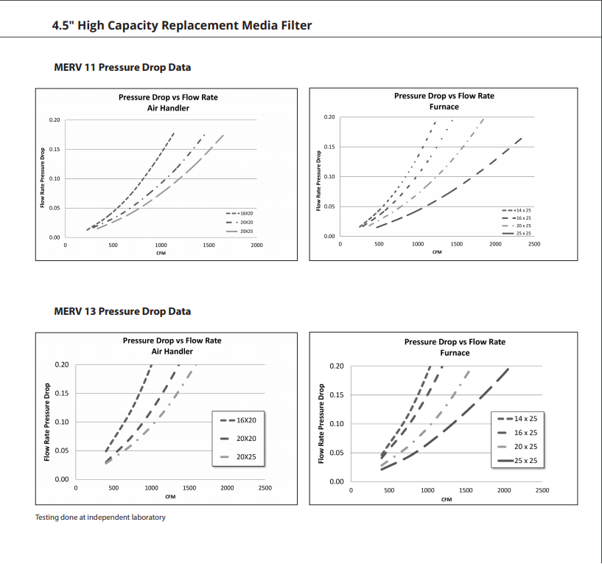
Filtration – Pressure Drop MERV 11 & 13
Notes:
Media Air Cleaners for our filtration lineup is our big seller. These are the best way to get the homeowner ready to do even more for there indoor air quality, so this is like the gateway drug for IAQ. We have 7 sizes so we match up with all the furnace and air handlers we offer. We even had the builder series that is all common sizes. Every size we have is the standard size so you don’t have to worry about things not fitting once you’re at the site. A cool thing about our filters is when we ship them, we do not put our clean comfort logo on the door. This is so you can place your company logo on the door so when the homeowner sees that it’s time to replace the filter they call you not us. That way you get the recurring revenue.

Slide 12
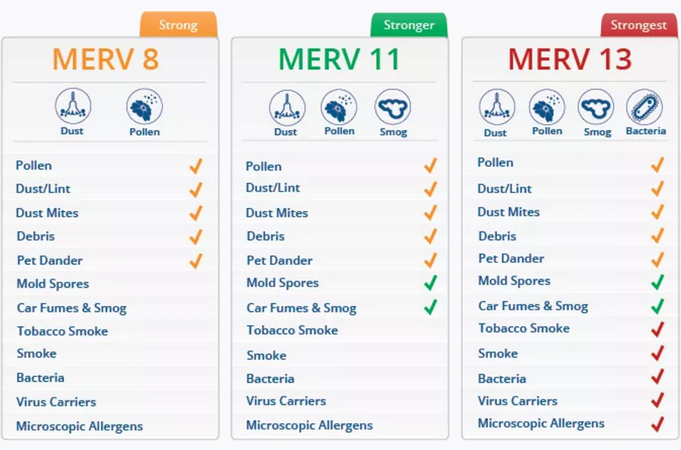
Filtration - MERV
Why MERV matters

Slide 13
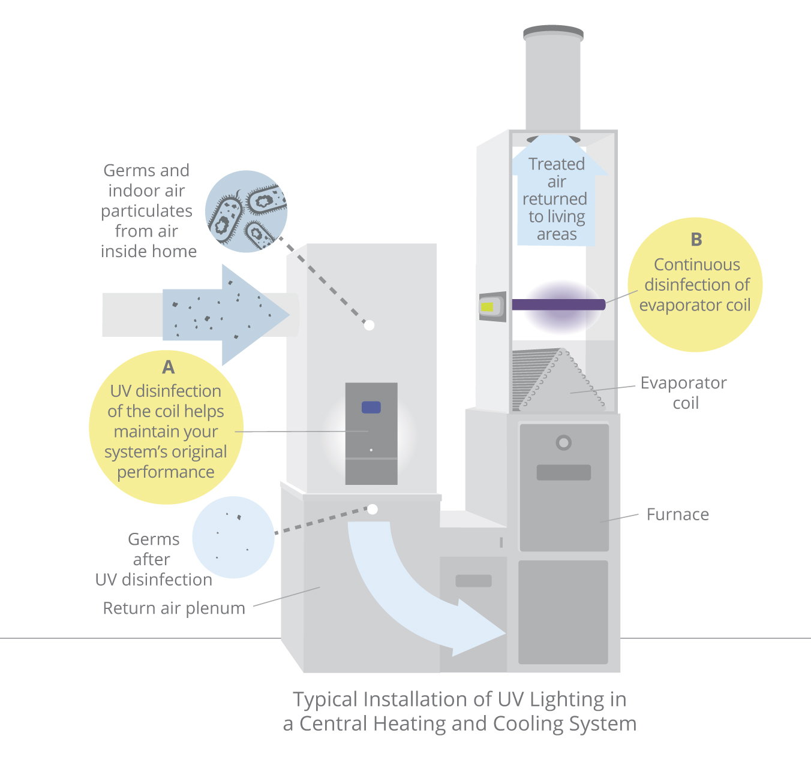
Purification - Air vs. Coil
Air Purifier
  Short exposure time
  Continuous disinfection of circulated air in the home
Coil Purifier
  Long exposure time
  Continuous disinfection of evaporator coil
Notes:
Purification, we separate this into two categories, Air vs. Coil. Air purifiers are more of our premium offerings and that is placed in the return duct. As the air moves through the return duct it passes through the air purifier and disinfects germs and indoor air particles from the home. This means its a short exposure time since air travels quickly. The Coil, on the other hand, can be placed above the evaporator coil or even inside of it and that has a longer exposer time since the evaporator coil never moves.

Slide 14
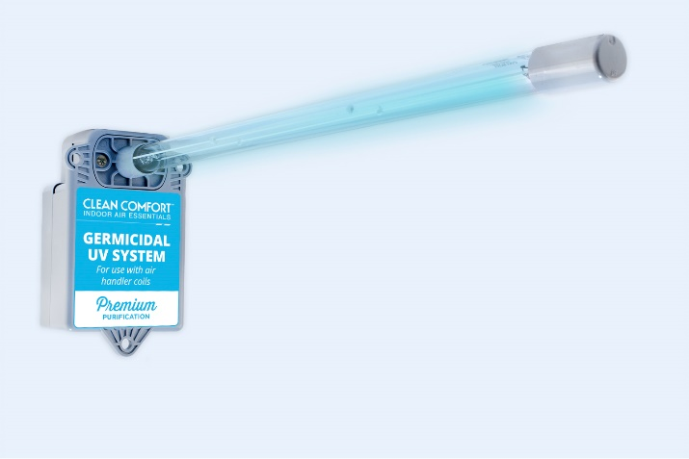
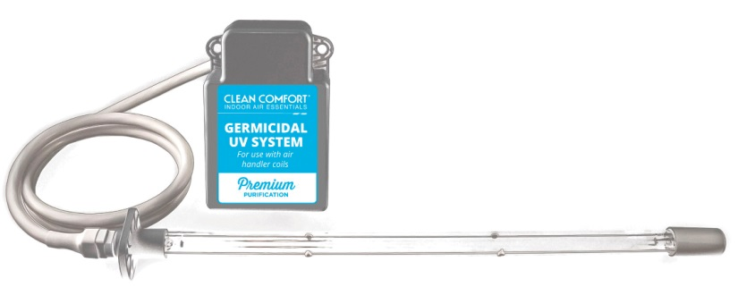
Clean Comfort UC18S Series – Coil Purification
UC18S15-24B “Premium”
  2 yr. Lamp, 7 yr. ballast
  Lamp Shield
  15-inch lamp
  Multiple install options
  Magnetic mounting bracket
  24V Power supply
UC18S15-24 “Value”
  1 yr. lamp, 5 yr. ballast
  15-inch lamp
  Multiple install options
  Magnetic mounting bracket
  24V Power supply
Notes:
Let’s take a look out our coil purifiers now. Like I said in the main picture these are placed above or inside of the Coil and they attack inhibit the growth of microbes on the evaporative coil. The UC 36 sits above and the UC18 sits inside. Our UC36 series is the higher-end model of our coil purification and that’s because it has higher watts. The reason it has higher watts is that it has two bulbs instead of the traditional single bulb. It also has a parabolic reflector that guides the UV light to shine directly down on the coil. Another great feature of our UC36 LCD, it allows you to program the LCD with your companies name and phone number via a USB. This allows the homeowners to know who to call when it’s time for a replacement bulb. UC18 mounts in the AH coil and our Goodman/Amana products have cutouts to allows easy installation. This is a very good unit for the price and our biggest seller.

Slide 15
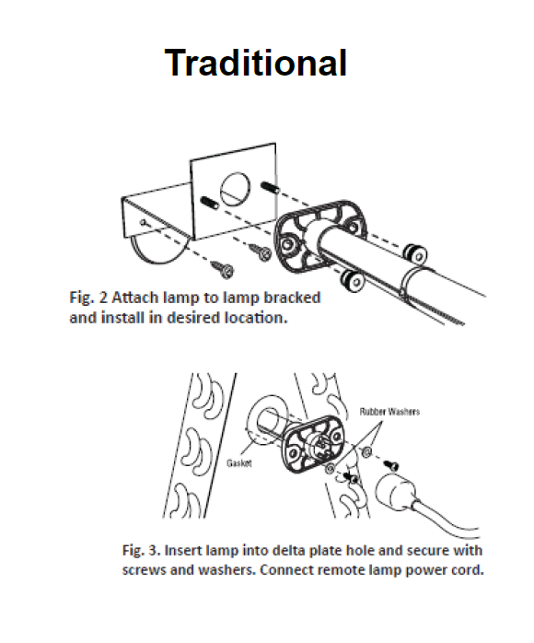
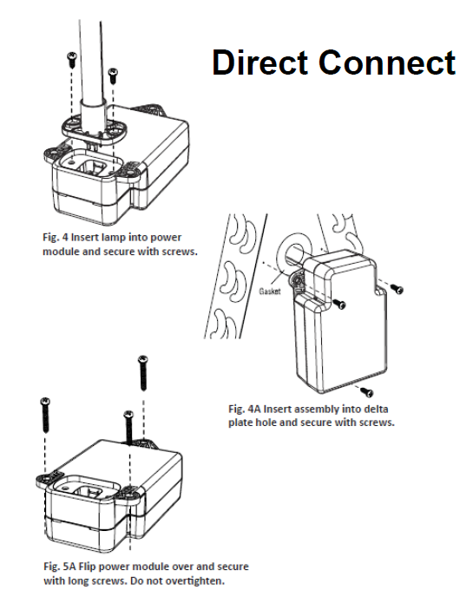
Clean Comfort UC18S Series – Mounting Options
Notes:
Let’s take a look out our coil purifiers now. Like I said in the main picture these are placed above or inside of the Coil and they attack inhibit the growth of microbes on the evaporative coil. The UC 36 sits above and the UC18 sits inside. Our UC36 series is the higher-end model of our coil purification and that’s because it has higher watts. The reason it has higher watts is that it has two bulbs instead of the traditional single bulb. It also has a parabolic reflector that guides the UV light to shine directly down on the coil. Another great feature of our UC36 LCD, it allows you to program the LCD with your companies name and phone number via a USB. This allows the homeowners to know who to call when it’s time for a replacement bulb. UC18 mounts in the AH coil and our Goodman/Amana products have cutouts to allows easy installation. This is a very good unit for the price and our biggest seller.

Slide 16
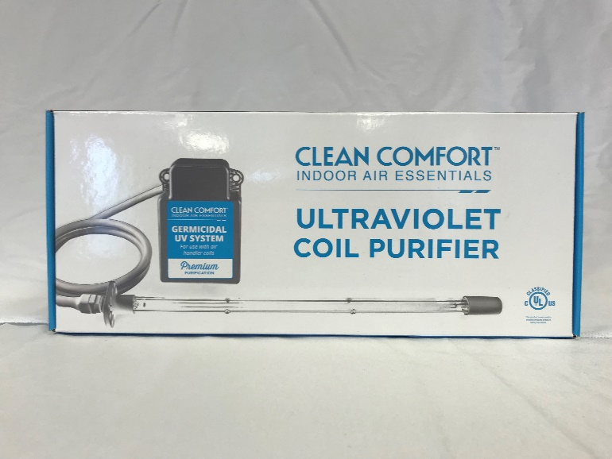
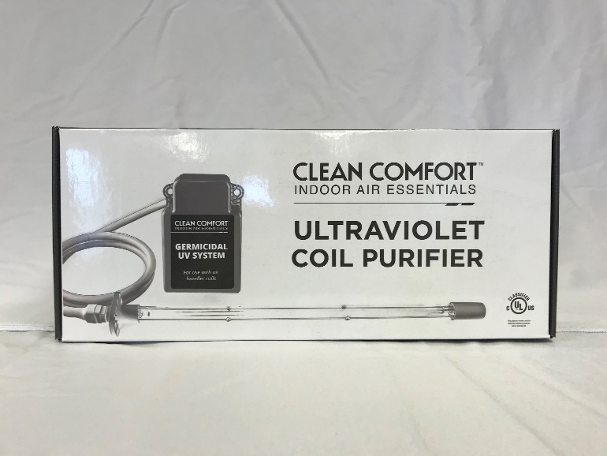
Clean Comfort UC18S Series – Packaging
Clean consumer electronic design
Improved graphics and product information
Easier to ship and merchandise
More value added for in home contractor presentations
Notes:
Let’s take a look out our coil purifiers now. Like I said in the main picture these are placed above or inside of the Coil and they attack inhibit the growth of microbes on the evaporative coil. The UC 36 sits above and the UC18 sits inside. Our UC36 series is the higher-end model of our coil purification and that’s because it has higher watts. The reason it has higher watts is that it has two bulbs instead of the traditional single bulb. It also has a parabolic reflector that guides the UV light to shine directly down on the coil. Another great feature of our UC36 LCD, it allows you to program the LCD with your companies name and phone number via a USB. This allows the homeowners to know who to call when it’s time for a replacement bulb. UC18 mounts in the AH coil and our Goodman/Amana products have cutouts to allows easy installation. This is a very good unit for the price and our biggest seller.

Slide 17
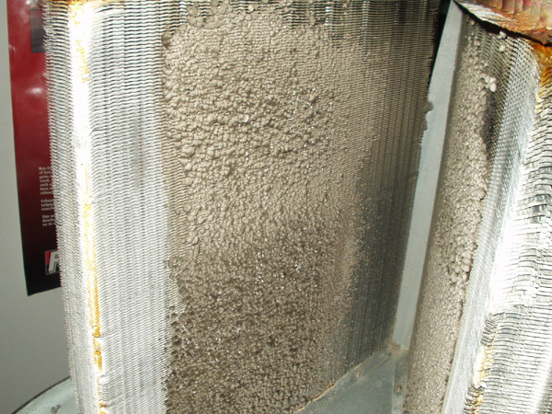
Clean Comfort UC18S Series – Why sterilize the coil
Biological growth insulates the coil
0.9 mm thick = 33% reduction in efficiency
Bacteria, viruses, mold and other issues can spread from a dirty coil into the air
Extend the life of the coil
Growth on the coil can block air flow increasing pressure drop in the system
Notes:
Let’s take a look out our coil purifiers now. Like I said in the main picture these are placed above or inside of the Coil and they attack inhibit the growth of microbes on the evaporative coil. The UC 36 sits above and the UC18 sits inside. Our UC36 series is the higher-end model of our coil purification and that’s because it has higher watts. The reason it has higher watts is that it has two bulbs instead of the traditional single bulb. It also has a parabolic reflector that guides the UV light to shine directly down on the coil. Another great feature of our UC36 LCD, it allows you to program the LCD with your companies name and phone number via a USB. This allows the homeowners to know who to call when it’s time for a replacement bulb. UC18 mounts in the AH coil and our Goodman/Amana products have cutouts to allows easy installation. This is a very good unit for the price and our biggest seller.

